Slide 1
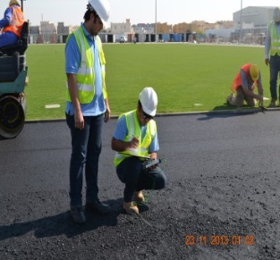
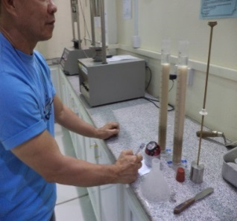
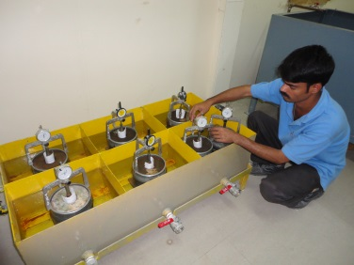
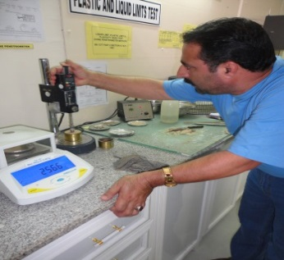
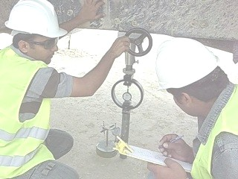
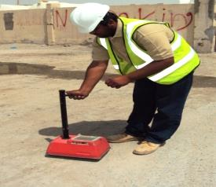
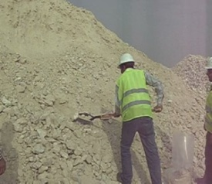
AL BARAHA
TECHNICAL LABORATORIES
COMPANY PROFILE
YOU BUILD IT
BATLABs TEST IT
Laboratory Testing
Field Testing & Monitoring
CONTACT DETAILS:
Al Kassarat , St. 41 (Intersection)
Bldg. 263, Zone 57
Industrial Area
Doha, Qatar
P.O Box 40572
Tel. No. +974 44501701
Fax No. +974 44509326
Email: info@bat-labs.com
Website: www.bat-labs.com
BATLABs provides advanced engineering services in Material Testing, QA/QC Management and Project Troubleshooting.
BATLABs’ goal is to take part in the Customers’ aim to provide a safe and reliable construction through timely and accurate testing services.

Slide 2
COMPANY PROFILE
TABLE OF CONTENTS
S. No. | Description | Page
1 | Introduction | 1
2 | BATLABS Quality Policy | 2
3 | Services Offered | 3 – 28
4 | Technical Affiliations | 29
5 | List of Projects (Current ASHGHAL Projects) | 30 – 32
6 | List of BATLABS Customers | 33
7 | BATLABS Credentials | 34 – 51

Slide 3
COMPANY PROFILE
1 - INTRODUCTION
Al Baraha Technical Laboratories also known as “BATLABS” was established on January 2004. The laboratory is located at St. 41 Al Kassarat St. (Intersection) Industrial Area, Doha Qatar.
BATLABS is a high caliber, independent technical testing laboratory specializing in construction related materials.
Tests and services conducted are the following: soil testing ; aggregate testing; pavement and asphalt testing; road marking testing; rock testing; concrete testing; chemical testing; drilling services, instrumentation and measurement, inspection and monitoring .
BATLABS endeavors to provide the highest quality testing services to construction industries. BATLABS’ goal is to take part in the customers’ aim to provide a safe and reliable construction through timely and accurate testing services.
BATLABS supports 101% the customers’ thrust towards optimization of the value of investment in catering to the increasing and sophisticated needs of the construction industry.
BATLABS has a well qualified and trained workforce. These hardworking staff continuously strive to enhance their qualifications through attending seminars, workshops and training sessions. In-house and external trainings are continuously provided to advance the technical knowledge of staff.
We, at BATLABS, remain to be…
“Your Dependable Project Partner”.
Page 1

Slide 4
COMPANY PROFILE
2 – BATLABS QUALITY POLICY
We at BATLABS are committed to achieve total customer satisfaction in the field of laboratory testing services specializing in construction related materials. With the vision to become a leading technical testing laboratory, we are set to create loyal and satisfied customers by providing superb and accurate service through highly effective system and highly trained workforce.
We are committed to achieve this by:
Developing good professional practices and providing testing
facilities that have the desired quality in accordance with
customer requirements / references standards. Hence, creating
an environment of trust and confidence with our customers,
Maintaining accuracy, precision and reliability of testing
services through the implementation, maintenance and
compliance with the applicable national and international
standards,
Achieving required quality of services that meets and exceeds
customers’ expectations,
Ensuring the respect of the confidentiality and impartiality principle through taking decisions based on objective evidence of compliance and not influenced by other interests or other parties.
Creating a culture and environment of excellence that
encourages and motivates our employees by imparting and
updating trainings with regards to quality procedures and
documentation,
Complying with the requirements of ISO/IEC 17025:2017 and
continually improving the effectiveness of the Management
System.
TAREK ABDALLAH
Laboratory Manager
Page 2

Slide 5
COMPANY PROFILE
3 – SERVICES OFFERED
Many industries are required to satisfy governmental regulations a variety of needs, deadlines and budget pressures. Let our engineers and project managers apply their industry knowledge of packaging, products and materials as well as the standards that regulate them to ensure compliance, manage timelines and provide value.
BATLABs offers a variety of services that support your business need for expertise, efficiency and solutions:
Combination Product Testing
Consumer Product Testing
Customized Package Testing
Laboratory Management
Packaging Materials Testing
Package Testing Consulting
Package Validation Testing
Materials Testing Services
BATLABs has experience across the construction materials testing industry – from routine laboratory testing to providing clients with specialized and unique solutions to emerging industry challenges.
Working across the geotechnical, material testing and consultancy fields, BATLABs provide the following services:
We, at BATLABs provide scales calibrations at Batching Plants using standard weights and in accordance to our own accredited procedure.
Page 3

Slide 6
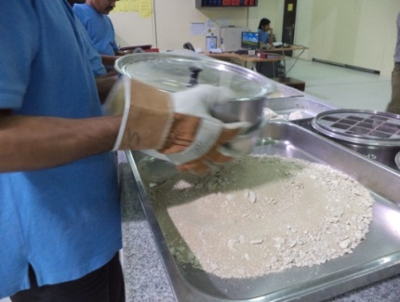
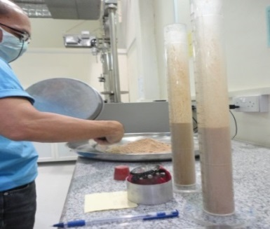
COMPANY PROFILE
3 – SERVICES OFFERED
Soil Division
BATLABs Soil Division is equipped with the most recent machineries and equipment to perform soil tests required by the customers.
Our accredited soil testing laboratories undertake a range of geotechnical and construction material testing to determinate the physical characteristics of soils.
S.No. | Laboratory Tests | Reference Standard
1 | Amount of Material in Soils Finer than No. 200 (75-m) Sieve | ASTM D1140
2 | Laboratory Compaction Characteristics of Soil Using Modified Effort (56,000 ft-lbf/ft3 (2,700 kN-m/m3) | ASTM D1557
3 | CBR (California Bearing Ratio) of Laboratory- Compacted Soils | ASTM D1883
4 | Laboratory Determination of Water (Moisture) Content of Soil and Rock by Mass | ASTM D2216
5 | Liquid Limit, Plastic Limit, and Plasticity Index of Soils | ASTM D4318
6 | Correction of Unit Weight and Water Content for Soils Containing Oversize Particles | ASTM D4718
7 | Particle-Size Distribution (Gradation) of Soils Using Sieve Analysis | ASTM D6913
Page 4

Slide 7
COMPANY PROFILE
3 – SERVICES OFFERED
S.N. | Laboratory Tests | Reference Standard
8 | Methods of test for soils for civil engineering purposes Part 2: classification tests (Determination of moisture content) | BS1377 Part 2 Clause 3
9 | Methods of test for soils for civil engineering purposes Part 2: Classification Tests (Determination of Liquid Limit (Cone Penetrometer)) | BS 1377 Part 2 Clause 4.3
10 | Methods of test for soils for civil engineering purposes Part 2: Classification tests (Atterberg Casagrande Method) | BS 1377 Part 2 Section 4.5
11 | Methods of test for soils for civil engineering purposes Part 2: Classification tests (Determination of Plastic Limit and Plasticity Index) | BS 1377 Part 2 Clauses 5.3 & 5.4
12 | Methods of test for soils for civil engineering purposes Part 2: Classification tests (Determination of Particle Size Distribution) | BS 1377 Part 2 Clauses 9.2 & 9.3
13 | Methods of test for soils for civil engineering purposes Part 4: Compaction-related tests (Determination of dry density / moisture content relationship) | BS 1377 Part 4 Clauses 3.5 and 3.6
14 | Methods of test for soils for civil engineering purposes Part 4: Compaction-related tests (Determination of California bearing ratio) | BS 1377 Part 4 Clause 7
Page 5

Slide 8
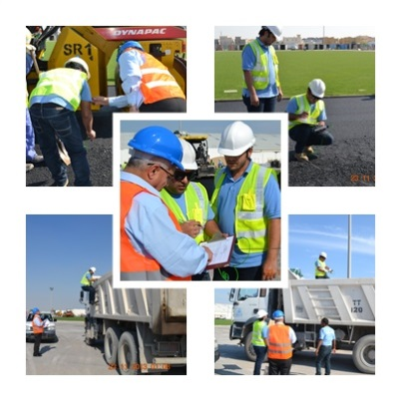
COMPANY PROFILE
3 – SERVICES OFFERED
Onsite Testing/Supervision/Inspection/Monitoring
BATLABs staff work in locations around Qatar, which may include remote annex laboratories on remote sites or major infrastructure projects.
Heaving a laboratory onsite ensures that results can be obtained quickly to meet project timelines and budgets.
BATLABs field testing services under taken onsite include:
Sampling and testing of soils
Sampling and testing of stockpiles to standards
Sand replacement testing
Nuclear density testing
Asphalt density
BATLABs provide supervision, inspection and monitoring services, including:
Level 1 – 2 supervision
Site assessments
Page 6

Slide 9
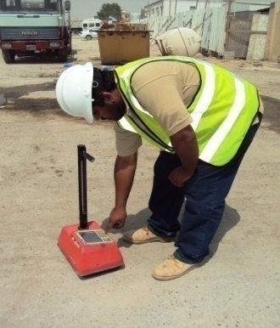
COMPANY PROFILE
3 – SERVICES OFFERED
Our staff are committed to delivering reliable, high quality results, which are setting international best practice and standards in line with QCS and other regulatory requirements.
S. No. | Field /Site Tests | Reference Standard
1 | Density and Unit Weight of Soil in Place by Sand-Cone Method | ASTM D15561
2 | In-Place Density and Water Content of Soil and Soil- Aggregate by Nuclear Methods (Shallow Depth) | ASTM D6938¹
3 | Methods of test for soils for civil engineering purposes Part 9: In-situ tests (Sand replacement method suitable for fine, medium and coarse-grained soils (large and small pouring cylinder method) | BS 1377 Part 9 Clauses 2.1 & 2.2¹
4 | Methods for test for soils for civil engineering purposes Part 9: In-situ tests (Filed Density test by Nuclear Gauge FDT) | BS 1377 Part 9 Clause 2.51
5 | Methods of test for soils for civil engineering purposes Part 9: In-situ tests Determination of in-situ California Bearing Ratio (CBR) | BS 1377 Part 9 Section 4.31
6 | Sampling Aggregates | ASTM D75/D75M¹
7 | Testing aggregate Part 102: methods for Sampling | BS 812 Part 1021
​
​
​
Page 7

Slide 10
COMPANY PROFILE
3 – SERVICES OFFERED
S. No. | Field/Site Tests | Reference Standard
1 | Density and Unit Weight of Soil in Place by Sand-Cone Method | ASTM D15561
2 | In-Place Density and Water Content of Soil and Soil- Aggregate by Nuclear Methods (Shallow Depth) | ASTM D6938¹
3 | Methods of test for soils for civil engineering purposes Part 9: In-situ tests (Sand replacement method suitable for fine, medium and coarse-grained soils (large and small pouring cylinder method) | BS 1377 Part 9 Clauses 2.1 & 2.2¹
4 | Methods for test for soils for civil engineering purposes Part 9: In-situ tests (Filed Density test by Nuclear Gauge FDT) | BS 1377 Part 9 Clause 2.51
5 | Methods of test for soils for civil engineering purposes Part 9: In-situ tests Determination of in-situ California Bearing Ratio (CBR) | BS 1377 Part 9 Section 4.31
6 | Sampling Aggregates | ASTM D75/D75M¹
7 | Testing aggregate Part 102: methods for Sampling | BS 812 Part 1021
8 | Sampling Asphalt Materials | ASTM D140/D140M1
9 | Sampling Bituminous Paving Mixtures | ASTM D979/D979M1
10 | Nuclear Density of Asphalt | ASTM D2950
11 | Estimating Application Rate and Residual Application Rate of Bituminous Distributors | ASTM D2995
​
​
​
Page 8

Slide 11
COMPANY PROFILE
3 – SERVICES OFFERED
S. No. | Field/Site Tests | Reference Standard
12 | Methods of test for soils for civil engineering purposes Part 9: In-situ tests In-situ vertical deformation and strength tests | BS 1377 Part 9 Section 4¹
13 | Sampling and examination of bituminous mixtures for roads and other paved areas. Methods of test for the determination of density and compaction (Density and thickness of asphalt cores) | BS 598 Part 104, Section 4
14 | Surface Irregularities in Concrete & Bituminous Road Surfaces by Travelling Beam Device | SOP/OPN/221
15 | Sampling and the Amount of Testing of Hydraulic Cement | ASTM C183/C183M1
16 | Making and Curing Concrete Test Specimens in the Field | ASTM C31¹
17 | Slump of Hydraulic-Cement Concrete | ASTM C143/C143M¹
18 | Sampling of Freshly Mixed Concrete | ASTM C1721
19 | Rebound Number of Hardened Concrete | ASTM C805/C805M¹
20 | Temperature of Freshly Mixed Hydraulic-Cement Concrete | ASTM C10641
21 | Testing fresh concrete. Part 1: Sampling | BS EN 12350 Part 1¹
22 | Testing fresh concrete Part 2: Slump test | BS EN 12350 Part 2¹
23 | Testing fresh concrete Part 5: Flow table test | BS EN 12350 Part 5¹
24 | Testing fresh concrete Part 6: Density | BS EN 12350 Part 6¹
25 | Testing fresh concrete Part 7: Air content. Pressure methods | BS EN 12350 Part 7¹
​
​
​
Page 9

Slide 12
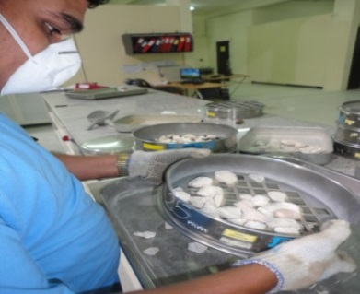
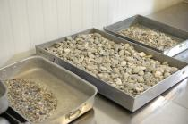
COMPANY PROFILE
3 – SERVICES OFFERED
3. Aggregate Division
BATLABS has set-up a modern testing facility to carry out Aggregate tests in accordance to QCS and BS/BS EN / ASTM Standards in the Aggregate Division.
S. No. | Laboratory Tests | Reference Standard
1 | Soundness of Aggregates by Use of Sodium Sulfate or Magnesium Sulfate | ASTM C88
2 | Materials Finer than 75-µm (No. 200) Sieve in Mineral Aggregates by Washing | ASTM C117
3 | Lightweight Particles in Aggregate | ASTM C123/C123M
4 | Density, Relative Density (Specific Gravity), and Absorption of Coarse Aggregate | ASTM C127
5 | Density, Relative Density (Specific Gravity), and Absorption of Fine Aggregate | ASTM C128
6 | Resistance to degradation of small - size coarse aggregate by abrasion and impact in the Los Angeles machine | ASTM C131
7 | Sieve Analysis of Fine and Coarse Aggregates | ASTM C136/C136M
8 | Clay Lumps and Friable Particles in Aggregates | ASTM C142/C142M
9 | Resistance to Degradation of Large-Size Coarse Aggregate by Abrasion and Impact in the Los Angeles Machine | ASTM C535
Page 10

Slide 13
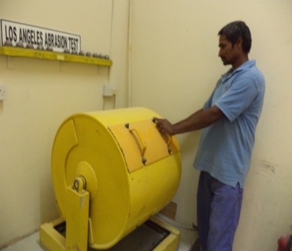
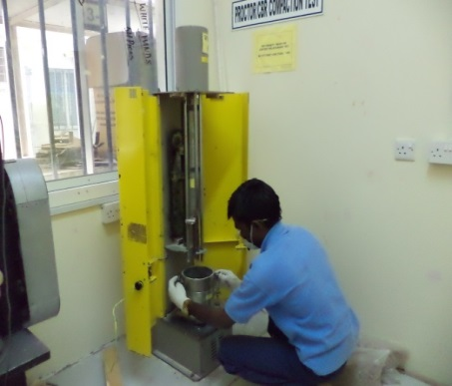
COMPANY PROFILE
3 – SERVICES OFFERED
Aggregates are used as a stable foundation with predictable, uniform properties. As such, their quality must be determined through specialist aggregate testing.
The better the quality, the more stable the construction.
S. No. | Laboratory Tests | Reference Standard
10 | Reducing Samples of Aggregate to Testing Size | ASTM C702/702M
11 | Sampling Aggregates | ASTM D75/D75M ¹
12 | Sand equivalent value of soils and fine aggregate | ASTM D2419
13 | Flat Particles, Elongated Particles, or Flat and Elongated Particles in Coarse Aggregate | ASTM D4791
14 | Fractured Particles in Coarse Aggregate | ASTM D5821
15 | Testing aggregates Part 2: Methods for determination of Density (Particle density and water absorption) | BS 812 Part 2 Clause 5.4
16 | Testing aggregate Part 102: methods for Sampling | BS 812 Part 102 ¹
17 | Testing aggregates Part 103: Method for determination of particle size distribution. Sieve tests | BS 812 Part 103 Section 103.1
18 | Testing aggregates Part 105: Methods for determination of particle shape. Flakiness index | BS 812 Part 105 Section 105.1
19 | Testing aggregates Part 105: Methods for determination of particle shape. Elongation index of coarse aggregate | BS 812 Part 105 Section 105.2
Page 11

Slide 14
COMPANY PROFILE
3 – SERVICES OFFERED
S. No. | Laboratory Tests | Reference Standard
20 | Testing aggregates Part 109: Methods for determination of moisture content (drying oven) | BS 812 Part 109
21 | Testing aggregates Part 110: Methods for determination of aggregate crushing value (ACV) | BS 812 Part 110
22 | Testing aggregates Part 111: Methods for Determination of Ten Per Cent Fines Value (TFV) | BS 812 Part 111
23 | Methods of testing cement Part 3: Determination of setting times and soundness | BS EN 196 Part 3
24 | Methods of testing cement Part 7: Methods of taking and preparing samples of cement | BS EN 196 Part 7 1
25 | Tests for geometrical properties of aggregates Part 1: Determination of particle size distribution. Sieving method | BS EN 933 Part 1
66 | ests for geometrical properties of aggregates Part 3: Determination of particle shape. Flakiness index | BS EN 933 Part 3
77 | Tests for geometrical properties of aggregates Part 4: Determination of particle shape. Shape index (Elongation Index) | BS EN 933 Part 4
28 | Shell Content Percentage of Shells in Coarse Aggregates | BS EN 933-7
Page 12

Slide 15
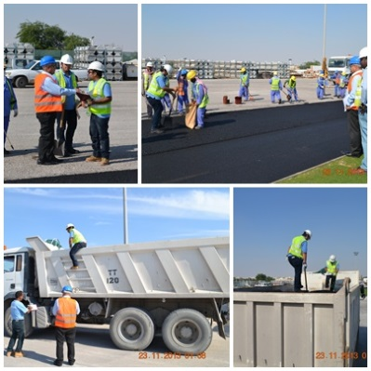
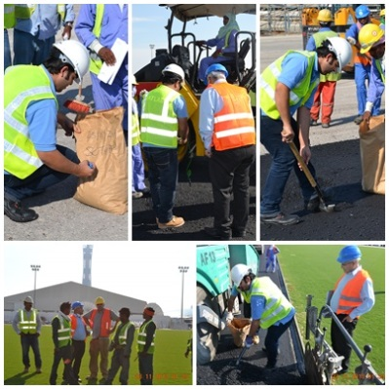
COMPANY PROFILE
3 – SERVICES OFFERED
BATLABs perform many tests on pavement and asphalt to be used in the construction and rehabilitation of pavements and roads.
Our pavement and asphalt testing services include:
Pavement evaluation and maintenance
Asphalt control and recycling review
S.No. | Field Tests | Reference Standard
1 | Asphalt Coring (of different thickness and lengths) | BS 598 Part 104
2 | Temperature Checking of Asphaltic Batch | BS EN 12697 Part 13
3 | Sampling of Asphalt Material | BS 598 : 100 BS EN 12697 : 27
4 | Sampling of Tack/Prime Coat Sheet | BS 598 ; 108
Page 13

Slide 16
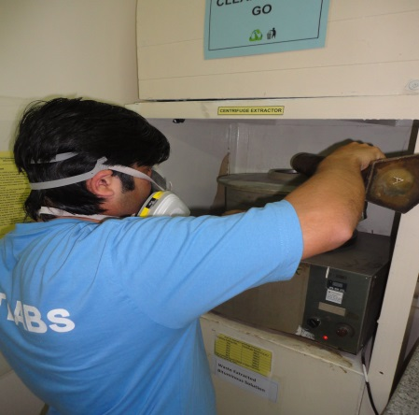
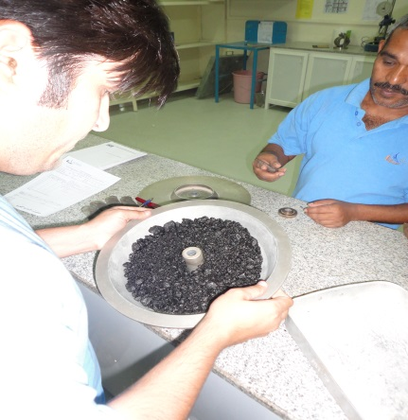
COMPANY PROFILE
3 – SERVICES OFFERED
4. Asphalt and Pavement Division
BATLABS’ Asphalt Division is equally equipped with up-to-date apparatuses for testing the physical, mechanical and chemical properties of asphalt and bitumen.
S. No. | Laboratory Tests | Reference Standard
1 | Penetration of Bituminous Materials | ASTM D5
2 | Softening Point of Bitumen (Ring-and-Ball Apparatus) | ASTM D36
3 | Sampling Asphalt Materials | ASTM D140/D140M ¹
4 | Sieve Analysis of Mineral Filler | ASTM D546
5 | Sampling Bituminous Paving Mixtures | ASTM D979/D979M ¹
6 | Bulk Specific Gravity and Density of Compacted Bituminous Mixtures Using Coated Samples | ASTM D1188
7 | Theoretical Maximum Specific Gravity and Density of Bituminous Paving Mixtures | ASTM D2041
8 | Bulk Specific Gravity and Density of Non-Absorptive Compacted Bituminous Mixtures | ASTM D2726/D2726M
Page 14

Slide 17
COMPANY PROFILE
3 – SERVICES OFFERED
S. No. | Laboratory Tests | Reference Standard
9 | Nuclear Density of Asphalt | ASTM D2950
10 | Estimating Application Rate and Residual Application Rate of Bituminous Distributors | ASTM D2995
11 | Percent Air Voids in Compacted Dense and Open Bituminous Paving Mixtures | ASTM D3203/D3203M
12 | Thickness or Height of Compacted Asphalt Mixture Specimens | ASTM D3549/D3549M
13 | Sampling Compacted Bituminous Mixtures for Laboratory Testing | ASTM D5361/D5361M¹
14 | Mechanical Size Analysis of Extracted Aggregate | ASTM D5444
15 | Bulk Specific Gravity and Density of Compacted Asphalt Mixtures Using Vacuum Sealing | ASTM D6752/D6752M
16 | Maximum Specific Gravity and Density of Asphalt Mixtures using Automatic Vacuum Sealing Method | ASTM D6857
17 | Preparation of Asphalt Mixture Specimens Using Marshall Apparatus | ASTM D6926
18 | Marshall Stability and Flow of Asphalt Mixtures | ASTM D6927
19 | Use of the Dynamic Cone Penetrometer in Shallow Pavement Applications | ASTM D6951/D6951M¹
20 | Reducing Sample of HMA to Test Size | AASHTO R 47
21 | Methods of test for soils for civil engineering purposes Part 9: In-situ tests In-situ vertical deformation and strength tests | BS 1377 Part 9 Section 4¹
22 | Bitumen and bituminous binders. Determination of the softening point. Ring and Ball method | BS EN 1427
Page 15

Slide 18
COMPANY PROFILE
3 – SERVICES OFFERED
S. No. | Laboratory Tests – (Asphalt Mixtures) | Reference Standard
23 | Density of Semi-Solid Bituminous Materials (Pycnometer Method) | ASTM D70
24 | Quantitative extraction of bitumen from bituminous paving mixtures | ASTM D2172
25 | Bulk Specific Gravity and Density of Non-Absorptive Comp Bituminous Mixtures (Determination of Bulk Density) | ASTM D2726, Clause 10.2
26 | Sampling and examination of bituminous mixtures for roads and other paved areas. Methods of test for the determination of density and compaction (Density and thickness of asphalt cores) | BS 598 Part 104, Section 4
27 | Sampling and examination of bituminous mixtures for roads and other paved areas. Method of test for the determination of the composition of design surface course rolled asphalt (Marshall stability and flow) | BS 598 Part 107
28 | Bitumen and bituminous binders. Determination of needlepenetration | BS EN 1426 BS 2000-49
29 | Bituminous mixtures. Test methods for hot mix asphalt. Soluble binder content | BS EN 12697-1
30 | Bituminous mixtures. Test methods for hot mix asphalt. Determination of the maximum density | BS EN 12697-5, Clause 9.3
31 | Bituminous mixtures. Test methods for hot mix asphalt. Determination of bulk density of bituminous specimens | BS EN 12697-6, Clauses 9.2 & 9.3
32 | Bituminous mixtures. Test methods for hot mix asphalt. Temperature measurement | BS EN 12697-13
33 | Bituminous mixtures. Test methods for hot mix asphalt. Sampling | BS EN 12697-27¹
34 | Bituminous mixtures. Test methods for hot mix asphalt. Determination of the dimensions of a bituminous specimen | BS EN 12697-29
35 | Bituminous mixtures. Test methods for hot mix asphalt. Specimen preparation by impact compactor | BS EN 12697-30
Page 16

Slide 19
COMPANY PROFILE
3 – SERVICES OFFERED
S. No. | Laboratory Tests – (Asphalt Mixtures) | Reference Standard
35 | Bituminous mixtures. Test methods for hot mix asphalt. Specimen preparation by impact compactor | BS EN 12697-30
36 | Bituminous mixtures. Test methods for hot mix asphalt. Marshall Test (Marshall stability and flow) | BS EN 12697-34
37 | Bituminous mixtures. Test methods for hot mix asphalt. Determination of the thickness of a bituminous pavement | BS EN 12697-36
38 | Bituminous mixtures. Test methods for hot mix asphalt. Part 28: Preparation of samples for determining binder content, water content and grading | BS EN 12697 Part 28
39 | Bituminous mixtures. Test method for hot mix asphalt Part 2: Determination of particle size distribution | BS EN 12697 Part 2
40 | Bituminous mixtures. Test methods for hot mix asphalt Part 8: Determination of void characteristics of bituminous specimens | BS EN 12697 Part 8
41 | Surface Irregularities in Concrete & Bituminous Road Surfaces By Travelling Beam Device | SOP/OPN/22¹
Page 17

Slide 20
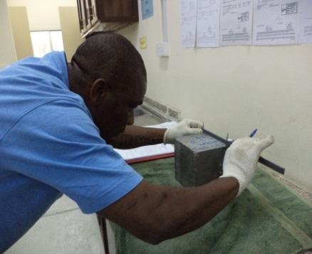
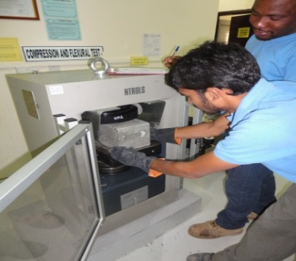
COMPANY PROFILE
3 – SERVICES OFFERED
Concrete Division
The Concrete Division of BATLABS has sufficient capability for testing fresh concrete, hardened concrete, masonry blocks, paving blocks, kerbstones and etc.
S.No. | Laboratory Tests | Reference Standard
1 | Making and Curing Concrete Test Specimens in the Field | ASTM C31¹
2 | Compressive Strength of Cylindrical Concrete Specimens | ASTM C39
3 | Density (Unit Weight), Yield, and Air Content (Gravimetric) of Concrete | ASTM C138/ C138M
4 | Sampling and Testing Concrete Masonry Units and Related Units | ASTM C140/C140M¹
5 | Slump of Hydraulic-Cement Concrete | ASTM C143/C143M¹
6 | Sampling of Freshly Mixed Concrete | ASTM C172¹
7 | Air Content of Freshly Mixed Concrete by the Pressure Method | ASTM C231/ C231M¹
8 | Chemical Admixtures for Concrete | ASTM C494/C494M
9 | Density, Absorption, and Voids in Hardened Concrete | ASTM C642
10 | Rebound Number of Hardened Concrete | ASTM C642
11 | Temperature of Freshly Mixed Hydraulic-Cement Concrete | ASTM C1064¹
12 | Electrical Indication of Concrete's Ability to Resist Chloride Ion Penetration Rapid chloride permeability test (RCPT) | ASTM C1202
Page 18

Slide 21
COMPANY PROFILE
3 – SERVICES OFFERED
S. No. | Laboratory Tests | Reference Standard
13 | Testing concrete. Part 111: Method of normal curing of test specimens (20°C method) Part 114: Testing concrete Methods for determination of density of hardened concrete Part 116: Method for determination of compressive strength of concrete cubes | BS 1881, Parts 111, 114, and 116¹
14 | Testing concrete Part 122: Method for determination of water absorption | BS 1881 Part 122
15 | Testing concrete Part 208: Recommendations for the determination of the initial surface absorption of concrete | BS 1881 Part 208
16 | General requirements, sampling, sample preparation and test on materials before stabilization | BS 1924-1
17 | Determination of Coefficient of Water Absorption due to Capillary Action of Masonry Units (And other related materials) | BS EN 772-11/BS EN 771-3
18 | Determination of Total Water Absorption of Paving Blocks | BS EN 1338 Annex E
19 | Determination of Total Water Absorption of Paving Flags | BS EN 1339 Annex E
20 | Measurement of Dimensions for Concrete Kerb Units | BS EN 1340 Annex C
21 | Determination of Total Absorption of Concrete Kerb Units | BS EN 1340 Annex E
22 | Testing fresh concrete. Part 1: Sampling | BS EN 12350 Part 1¹
23 | Testing fresh concrete Part 2: Slump test | BS EN 12350 Part 2¹
24 | Testing fresh concrete Part 5: Flow table test | BS EN 12350 Part 5¹
Page 19

Slide 22
COMPANY PROFILE
3 – SERVICES OFFERED
S. No. | Laboratory Tests | Reference Standard
25 | Testing fresh concrete Part 6: Density | BS EN 12350 Part 6¹
26 | Testing fresh concrete Part 7: Air content. Pressure methods | BS EN 12350 Part 7¹
27 | Testing hardened concrete Part 1: Shape, dimensions and other requiremmolds Part 3: Compressive strength of test specimensPart 7: Density of hardened concrete | BS EN 12390, Parts 1, 3, and 7
28 | Testing hardened concretePart 2: Making and curing specimens for strength tests | BS EN 12390 Part 2¹
29 | Testing concrete in structures Part 1: Cored specimen– taking, examining and testing in Compression | BS EN 12504 Part 1
30 | Testing hardened concrete. Part 8: Depth of penetration of water under pressure | BS EN 12390 Part 8
31 | Determination of the Compressive Strength of Hydraulically Bound Mixtures | BS EN 13286-41
32 | Method for the manufacture of test specimens of hydraulic bound mixtures u sing vibrating hammer compaction | BS EN 13286-51
33 | Water Absorption of Terrazzo Tiles | BS EN 13748 Part 1 5.5/5.8
34 | Testing Concrete; Testing of Hardened Concrete (specimens prepared in mold) Part 5: Water Permeability Test of Hardened Concrete | DIN 1048 Part 5
35 | Absorption of Water by Concrete by Immersion Under Vacuum | RILEM TC14 CPC 11.3
36 | Chloride ion migration | NT Build 492-11
37 | Precast concrete masonry units, measurement of dimension | BS 6073 Appendix A
38 | Precast concrete masonry units, determination of compressive strength | BS 6073 Appendix B
39 | Precast concrete paving blocks Part 1: Determination of compressive strength | BS 6717 Part 1 Ann. A & B
Page 20

Slide 23
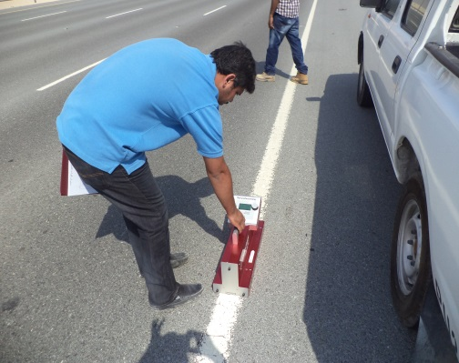
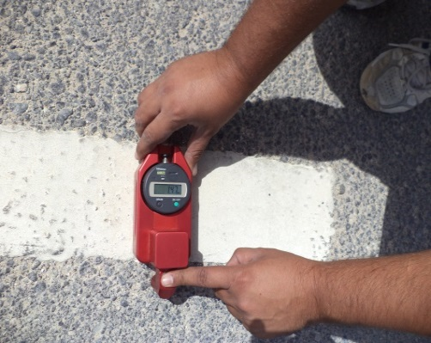
COMPANY PROFILE
3 – SERVICES OFFERED
5. Road Marking Division
S. No. | Road Marking Services | Reference Standard
1 | Thickness of Road Marking Materials | BS 3262 Part 3
2 | Measurement of the Luminance Coefficient Under Diffuse Illumination of Pavement Marking Materials Using a Portable Reflectometer | ASTM E 2302
3 | Measurement of Retroreflective Pavement Marking Materials with CEN-Prescribed Geometry Using a Portable Retroreflectometer | ASTM E 1710
4 | Road marking materials. Road marking performance for road users Determination of Skid Resistance | BS EN 1436 +A1
5 | No-Pick-Up Time of Traffic | ASTM D711
Page 21

Slide 24
COMPANY PROFILE
3 – SERVICES OFFERED
6. Rock Testing Division
Our laboratory in Qatar has acquired the latest technology in rock testing with a unique assemblage of equipment.
The primary aim of this specialist rock testing laboratory is to predict the performance of rock excavating equipment under various geological conditions.
We have suites of tests to predict the performance of the following equipment under different geological conditions :
S. No. | Rock Testing Services Division
1 | Diamond Drilling
2 | Percussive Drilling – DTH
3 | Percussive Drilling – Top Hammer
4 | Raise and Shaft Drilling over 2 m diameter
5 | Raise borders under 3 m diameter
6 | Road Headers
7 | Rotary Drilling
8 | Trenching
9 | Tunnel Boring Machines
Page 22

Slide 25
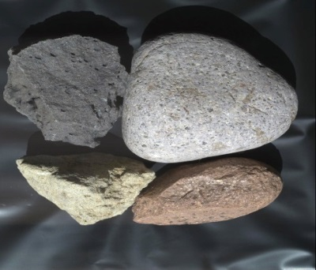
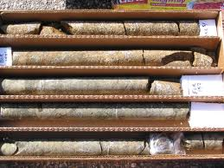
COMPANY PROFILE
3 – SERVICES OFFERED
The individual tests used in the above predictive tests are described here:
Physical Properties
(the results of non destructive tests)
Mechanical properties
(the results of destructive tests)
Abrasiveness
Toughness
Drillability
Empirical correlations and predictions
Splitting Tensile Strength of Intact Rock Core
(ASTM 3967)
Compressive Strength
Page 23

Slide 26
COMPANY PROFILE
3 – SERVICES OFFERED
7. Drilling Services
Geotechnical drilling allows investigation of subsurface materials and conditions and enables the reliable assessments of risks posed by these conditions.
It can also be used to determine the impact of groundwater on soils by determining its location, movement and depth.
S. No. | Drilling Services
1 | Geotechnical Site Investigation
2 | Flight Auger/Mud Drillings
3 | Drilling Supervisor
4 | Borehole Logging
5 | Rock Core Logging
6 | CPT Drilling and Testing
Page 24

Slide 27
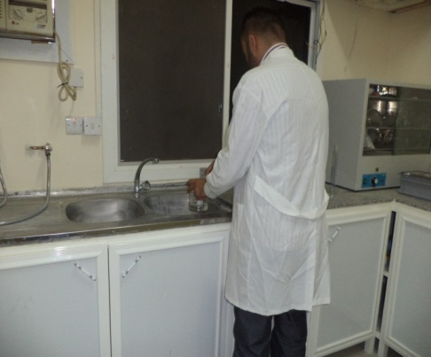
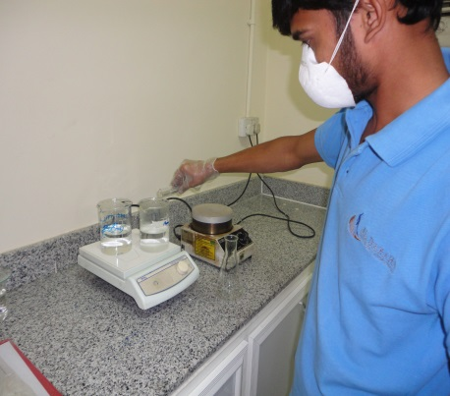
COMPANY PROFILE
3 – SERVICES OFFERED
9. Chemical Division
BATLABS’ possesses advanced chemical testing equipment in order to perform chemical tests required by customers.
S. No. | Laboratory Tests | Reference Standard
1 | Testing concrete Part 124: Methods for analysis of hardened concrete (Determination of Sulphate content in hardened concrete) | BS 1881 Part 124, Clause 10.3
2 | Testing concrete Part 124: Methods for analysis of hardened concrete (Determination of Chloride content in hardened concrete) | BS 1881 Part 124, Clause 10.2
3 | Method of testing cement Part 2: Chemical analysis of cement Sul phate | BS EN 196 Part 2
4 | Method of testing cement Part 2: Chemical analysis of cement Chloride | BS EN 196 Part 2
5 | Admixtures for concrete, mortar and grout. Test methods. Reference concrete and reference mortar for testing Chloride Content of Admixture | BS EN 480
Page 25

Slide 28
COMPANY PROFILE
3 – SERVICES OFFERED
S. No. | Laboratory Tests | Reference Standard
6 | Standard Test Method for Organic Impurities in Fine Aggregates for Concrete | ASTM C40/C40M
7 | Chemical Admixtures for Concrete | ASTM C494/C494M
8 | Specific Gravity, Apparent, of Liquid Industrial Chemicals | ASTM D891
9 | Testing aggregates. Method for determination of water-soluble chloride salts | BS 812 Part 117 Appendix C
10 | Testing aggregates. Methods for determination of Sulfate content | BS 812 Part 118 Clause 6
11 | Tests for chemical properties of aggregates. Chemical analysis Determination of Acid Soluble Sulfate in Aggregates | BS EN 1744-1+A1
12 | Tests for chemical properties of aggregates. Determination of acid soluble chloride salts | BS EN 1744-5
13 | Method of testing cement: Part 2: Chemical analysis of cement -Loss on ignition | BS EN 196 Part 2, Clause 4.4.1
14 | Method of testing cement: Part 2: Chemical analysis of cement - Insoluble residue | BS EN 196 Part 2, Clause 4.4.3
15 | Method of testing cement: Part 2: Chemical analysis of cement - Impure silica | BS EN 196 Part 2, Clause 4.5.5
16 | Method of testing cement: Part 2: Chemical analysis of cement - Pure silica | BS EN 196 Part 2, Clause 4.5.5
17 | Method of testing cement Part 2: Chemical analysis of cement Calcium | BS EN 196 Part 2, Clause 4.5.14
18 | Method of testing cement Part 2: Chemical analysis of cement - Aluminum | BS EN 196 Part 2, Clause 4.5.11
19 | Method of testing cement Part 2: Chemical analysis of cement -Iron oxide | BS EN 196 Part 2, Clause 4.5.10
20 | Method of testing cement Part 2: Chemical analysis of cement Magnesium oxide | BS EN 196 Part 2, Clause 4.5.15
Page 26

Slide 29
COMPANY PROFILE
3 – SERVICES OFFERED
S. No. | Laboratory Tests | Reference Standard
21 | Methods of test for soils for civil engineering purposes. Chemical and electro-chemical tests (Determination of acid soluble sulfate content) | BS 1377 Part 3, Clause 5
22 | Methods of test for soils for civil engineering purposes. Chemical and electro-chemical tests (Determination of acid soluble chloride content) | BS 1377 Part 3, Clause 9
23 | Methods of test for soils for civil engineering purposes. Chemical and electro-chemical tests (pH value) | BS 1377 Part 3, Clause 9
24 | Methods of test for soils for civil engineering purposes. Part 3: Chemical and electro-chemical tests: Determination of the organic matter content Clause 3 | BS 1377 Part 3, Section 3
25 | Methods of test for soils for civil engineering purposes. Part 3: Chemical and electro-chemical tests Determination of Carbonate Content | BS 1377 Part 3, Section 6
26 | Methods of test for soils for civil engineering purposes. Part 3: Chemical and electro-chemical tests Determination of the chloride content Determination of Water Soluble Chloride Content of Soil | BS 1377 Part 3, Section 7
27 | Methods of test for soils for civil engineering purposes. Part 3: Chemical and electro-chemical tests (Determination of the sulphate content of soil and ground water) Determination of Water Soluble Sulphate Content of Soil | BS 1377 Part 3, Section 5
28 | pH | APHA 4500 H +B: 22nd Edition 2012
29 | Electrical Conductivity | APHA 2510 B: 22nd Edition 2012
Page 27

Slide 30
COMPANY PROFILE
3 – SERVICES OFFERED
S. No. | Laboratory Tests | Reference Standard
30 | Total Dissolved Solids at 180 ° C. | APHA 2540 C: 22nd Edition 2012
31 | Chemical Oxygen Demand | APHA 5220 D: 22nd Edition 2012
32 | Alkalinity, Carbonate, Bicarbonate, Hydroxide Alkalinity | APHA 2320 B: 22nd Edition 2012
33 | Sampling | SOP/OPN/28
34 | Turbidity | APHA 2130 B: 22nd Edition 2012
35 | Nitrogen-Ammonia | HACH Method 8038
36 | Nitrogen-Nitrate | HACH Method 8039
37 | Chlorine | HACH Method 8021 (Adapted method of APHA 4500 Cl G): 22nd Edition 2012
38 | Chloride | APHA 4500 Cl –B: 22nd Edition 2012
39 | Phosphorus | HACH Method 8048 (Adapted method of APHA 4500 –P E): 22nd Edition 2012
40 | Sulphate | APHA 4500 SO4 2-C: 22nd Edition 2012
41 | Iron | HACH Method 8008
42 | Hardness | APHA 2340 C: 22nd Edition 2012
43 | Magnesium | APHA 3500-Mg B: 22nd Edition 2012
44 | Calcium | APHA 3500-Ca B 22nd Edition 2012
45 | Copper | HACH Method 8506 (Adapted method of APHA 3500-Cu C): 22nd Edition 2012
Page 28

Slide 31
COMPANY PROFILE
4 – TECHNICAL AFFILIATION
BATLABS is legally registered with QGOSM (MLD), recognized by ASHGHAL and possesses all legal compliances and commercial registration. In addition, BATLABS is an ISO / IEC 17025:2017 accredited laboratory with 269 scope parameters including Site Laboratory. ASTM, BSEN, APHA are major reference standards being administered by Qatar Construction Specifications (QCS 2014).
We are the First Construction Material Testing Lab in Qatar to obtain the accreditation (from A2LA) of ISO/IEC 17025:2017. It is also entitled with the prestige of being the “ONLY LAB” having this accreditation all over Qatar and also “the ONLY LAB “ among the “ASHGHAL (Qatar government body for infrastructural Development) approved testing labs in Qatar”
Page 29

Slide 32
COMPANY PROFILE
5 – LIST OF CURRENT ASHGHAL PROJECTS
BATLABS was involved in various projects that has served a wide range of customers. The following projects are the current projects we are working with:
S. No. | PROJECT NAMES | CONTRACTOR | CONSULTANT | CONTRACT NO.
1 | A-Ring Road Interim Improvement | Boom Construction Company | ITAL Consult | C/2018/53
2 | Central Doha and Corniche Beautification - Package 3 | Boom Construction Company | Parsons International Limited | C/2020/91
3 | Construction of Flood Prevention Scheme (FPS – Phase 3) for Doha North Areas - C850/1 | Boom Construction Company | Parsons International Limited | C/2020/58
4 | Construction of Foul Sewer Network for Inner Doha – Package 2 C816/2 | GEC Contracting Services and Trading | Consulting Engineering Group International | C/2018/100
5 | Construction of Foul Sewer Network for Inner Doha- Package 3B C816/3B | Lotus Trading and Contracting Company | CDM Smith | C/2020/123
6 | Construction of Foul Sewers for Inner Doha C816-Package 1 | Lotus Trading and Contracting Company | Dorsch Qatar | C/2017/116
7 | Construction of Khufoos Street (P029 C1 ) | Boom Construction Company | CDM Smith | C/2017/102
8 | Construction of Sewage Pumping Station PS 25/9A(N) in Katara – C818 | Metito Overseas Qatar | ENGICON Qatar | C/2021/56
9 | Design & Build Contract for Al Wukair Pumping Station & Associated Works C845/A | Metito Overseas Qatar | Dorsch Qatar | C/2020/119
10 | Design and Build of West Bay Central Bus Station and Water Transport Ferry Terminals at Various Locations | Infraroad Trading and Contracting, Urbacon Trading and Contracting | AECOM Qatar | C/2021/24
Page 30

Slide 33
COMPANY PROFILE
5 – LIST OF CURRENT ASHGHAL PROJECTS
BATLABS was involved in various projects that has served a wide range of customers. The following projects were successfully completed;
S. No. | PROJECT NAMES | CONTRACTOR | CONSULTANT | CONTRACT NO.
11 | Design and Construct New Orbital Highway and Truck Route P023 Contract 2 – Orbital Highway: Salwa Road To North Relief Road | QDVC / Bin Omran Trading and Contracting Company | AECOM Qatar | C/2013/109
12 | Framework Agreement for Call-off Contracts for Landscaping and Ancillary Works | ELEGANCIA Landscape | ITAL Consult | C/2018/139
13 | Framework Agreement for Call Off Contracts for Landscaping Irrigation and Ancillary Works | Boom General Contractor (BGC) | ITAL Consult | C/2019/74
14 | Miscellaneous House Connection Works, Qatar North, FW-01-2021 | Lotus Trading and Contracting Company | N/A | C/2021/84
15 | Miscellaneous House Connection Works, Qatar South, FW-03-2021 | Metito Overseas Qatar | N/A | C/2021/86
16 | Miscellaneous House Connections, Work Order No. Sr_116 | Metito Overseas Qatar | ASHGHAL-Internal | C/2020/06
17 | PWA/GTC/023/2017/L – Upgrade of Al Wakrah Main Road (P017 C1-IN) | Boom Construction Company | Jacobs Engineering Group | C/2018/57
18 | PWA/GTC/048/2019 & PWA/GTC/049/2019 - Roads & Infrastructure in Mebaireek (Zone 81) - Package 01 & Package 2 | Boom Construction Company | ITAL Consult | C/2020/124
19 | RIW (SCDL) Park and Ride and Non-Stadium Bus Infrastructure Works - Package 2 | Qatar Building Company | Parsons International Limited | C/2022/3
20 | RIW for Junctions & Roundabouts in Various Areas of Greater Doha Phase 8 | Boom Construction Company | Gulf Engineering and Industrial Consultancy | C/2019/62
Page 31

Slide 34
COMPANY PROFILE
5 – LIST OF CURRENT ASHGHAL PROJECTS
BATLABS was involved in various projects that has served a wide range of customers. The following projects were successfully completed;
S. No. | PROJECT NAMES | CONTRACTOR | CONSULTANT | CONTRACT NO.
21 | RIW in Rayyan Areas Phase 5A | Boom Construction Company | Gulf Engineering and Industrial Consultancy | C/2019/58
22 | RIW in Rayyan Areas- 6B | Group Nine Joint Venture Trading and Contracting / ERAM EQUIPMENT RENTAL | ITAL Consult | C/2020/103
23 | RIW South of Greater Doha Zone 90 to 95 Phase – 6B | Al Muntasser Contracting and Trading | N/A | C/2020/105
24 | Road and Infrastructure in Al Sailiya / Al Atiya Housing & Al Atiya Army Camp Road | Qatar Building Company | ITAL Consult | C/2018/99
25 | Road Maintenance - Doha South Area 3 | Boom Construction Company | N/A | C/2020/48
26 | Roads and Infrastructure Doha Industrial Area Package 4 (QS001-P04) | Boom Construction Company,Lotus Trading and Contracting Company | Dar Al Handasah Consultants | C/2017/119
27 | Roads and Infrastructure in Al Mearad and Southwest of Muaither - Package 02 (DW044-P02) | Marbu Contracting Company WLL | CDM Smith | C/2019/132
28 | Roads and Infrastructure in Doha Industrial Area-Package 7 | Qatar Building Company | CDM Smith | C/2019/129
29 | Roads and Infrastructure in West Muaither (Al Manaseer)-Package 03 | Boom Construction Company | ITAL Consult | C/2019/5
Page 32

Slide 35
COMPANY PROFILE
6 – LIST OF BATLABS CUSTOMERS
BATLABS has worked for a wide range of customers as an Independent Testing Laboratory.
Boom Construction Company W.L.L
Bin Omran Trading & Contracting Co. L.W.W
Lotus Trading & Contracting
Qatar Building Company
UCC (Urbacon Contracating & Trading)
Golden Tower Construction
Ultracrete
Urbacon Trading & Contracting
Hyundai Engineering
CCC/TCC JV
Ternas Trading & Contracting
Kahramaa
QBS International
Al Waha Contracting & Trading
Public Works Authority
Hassan Ali Bin Ali Ready Mix
Midmac Colas
Al Bawakir Unicon Company W.L.L
Janas Contracting
Mideco Trading & Contracting
Buzwair Engineering & Contracting
Sanah Contracting
Al Kholafaa
Sea Shore
Al Khayyat Contracting & Trading
Al Jaber Trading & Contracting
MATTA Contracting Qatar
Arabian Masters Trading and Contracting (AMTC)
Al Mohanna Trading and Contracting
Galfar Al Misnad
Saad Bin Hassan
Al Watan Trading and Contracting Co.
Hassan Ali Bin Ali (HABA)
Noors Engineering
Aswan Trading and Contracting
Gulf Contracting Co. W.L.L.
Al Sraiya Trading and Contracting Co.
Qatar University
Ras Laffan Industrial City
The Arab Architechs
Umm Salal Municipality
Petroserve Ltd.
Qatar Petroleum
Aamal Cement Industries
Geotechnical Group
Qatar Asphalt Plant Co.
Castle Construction
Fugro
National Block Company
Metito
Elegancia Landscape
Marbu Contracting Company
Ternas Trading & Contracting
GEC Contracting Services
Babylon Landscape
Group 9 Joint Ventures
CTL Group Qatar
QDVC
GEC Contracting Services and Trading
Al Muntasser Contracting and Trading
Page 33

Slide 36
COMPANY PROFILE
7 – BATLABS CREDENTIALS
ISO / IEC : 17025 – 2017 Certificate
Page 34

Slide 37
COMPANY PROFILE
7 – BATLABS CREDENTIALS
ISO / IEC : 17025 – 2017 Certificate
Page 35

Slide 38
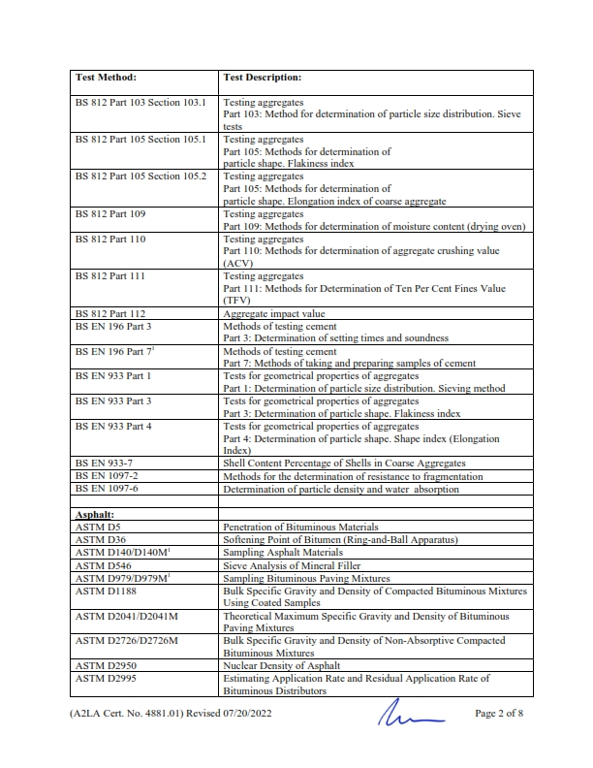
COMPANY PROFILE
7 – BATLABS CREDENTIALS
ISO / IEC : 17025 – 2017 Certificate
Page 36

Slide 39
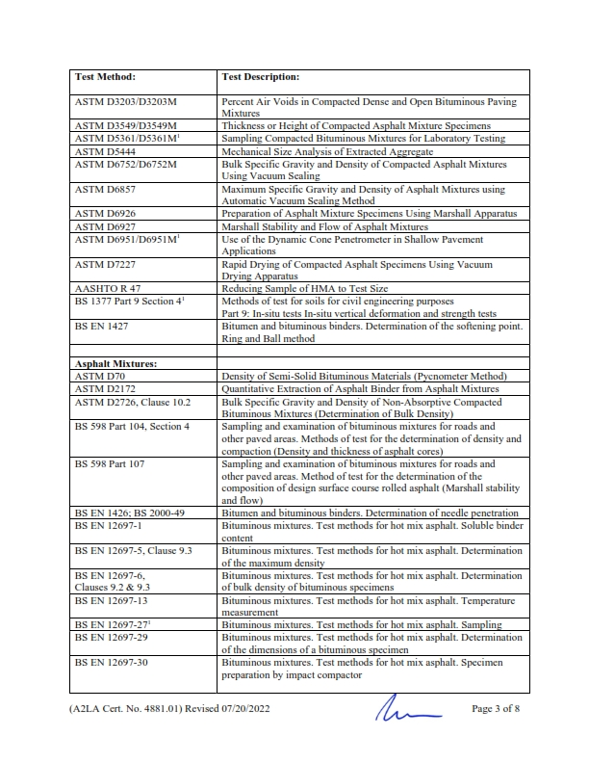
COMPANY PROFILE
7 – BATLABS CREDENTIALS
ISO / IEC : 17025 – 2017 Certificate
Page 37

Slide 40
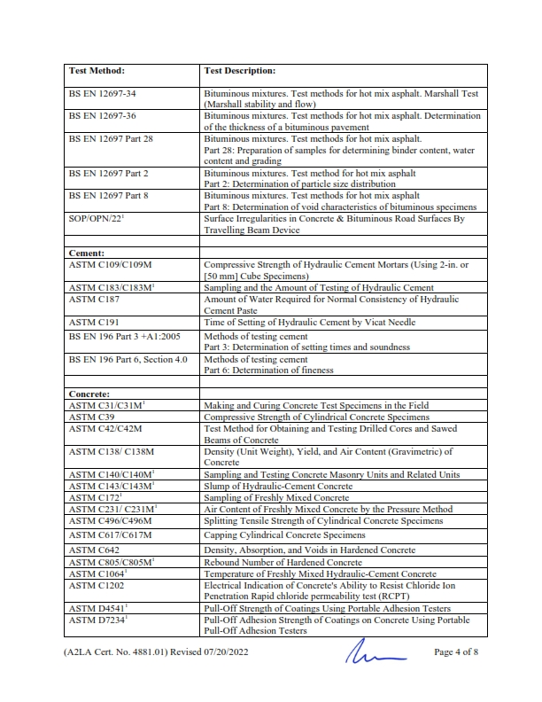
COMPANY PROFILE
7 – BATLABS CREDENTIALS
ISO / IEC : 17025 – 2017 Certificate
Page 38

Slide 41
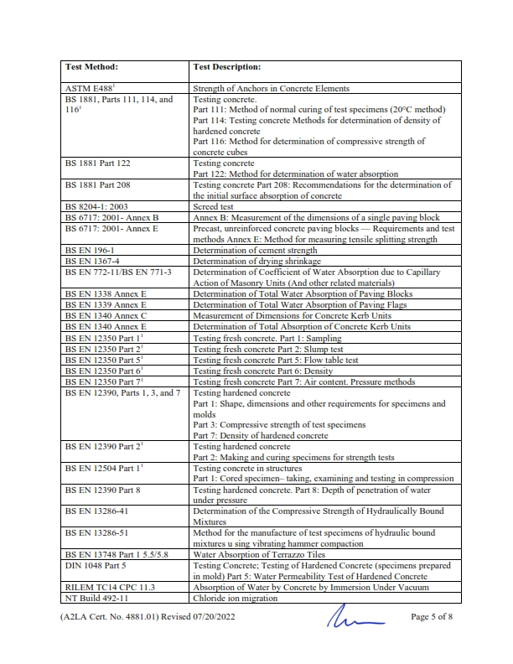
COMPANY PROFILE
7 – BATLABS CREDENTIALS
ISO / IEC : 17025 – 2017 Certificate
Page 39

Slide 42
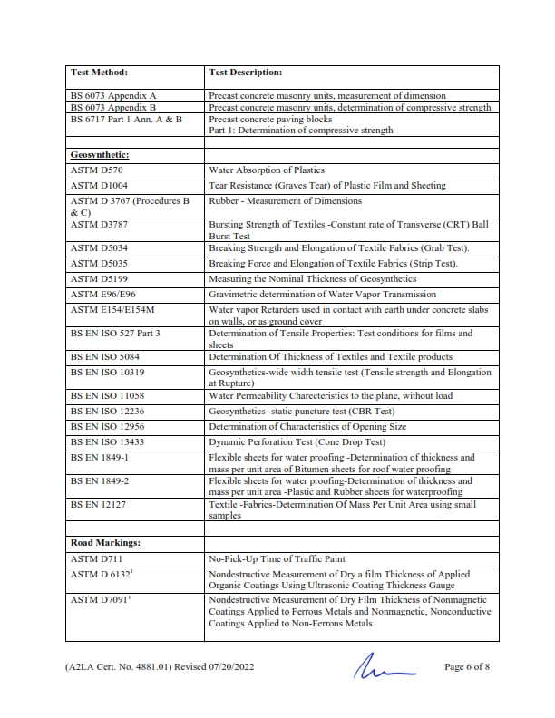
COMPANY PROFILE
7 – BATLABS CREDENTIALS
ISO / IEC : 17025 – 2017 Certificate
Page 40

Slide 43
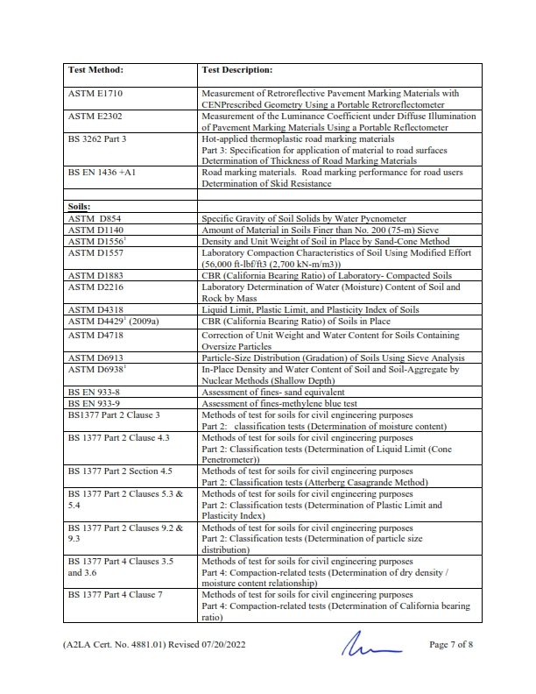
COMPANY PROFILE
7 – BATLABS CREDENTIALS
ISO / IEC : 17025 – 2017 Certificate
Page 41

Slide 44
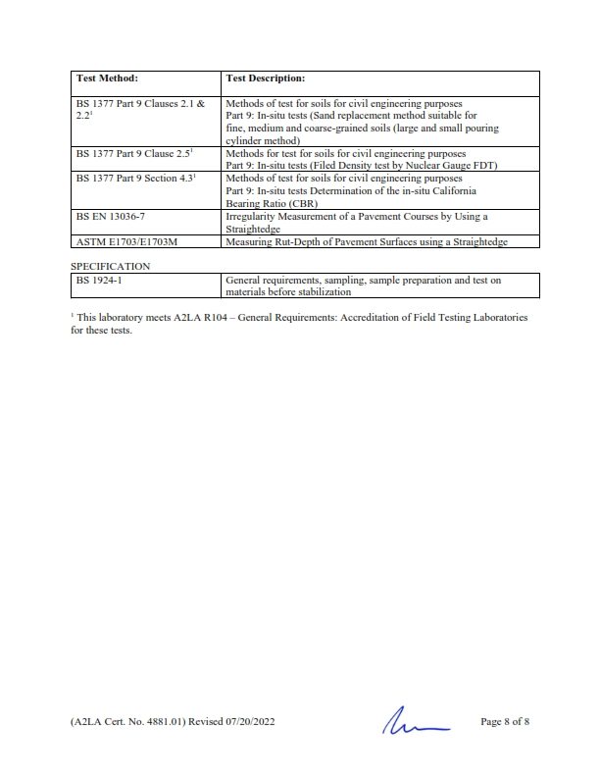
COMPANY PROFILE
7 – BATLABS CREDENTIALS
ISO / IEC : 17025 – 2017 Certificate
Page 41

Slide 45
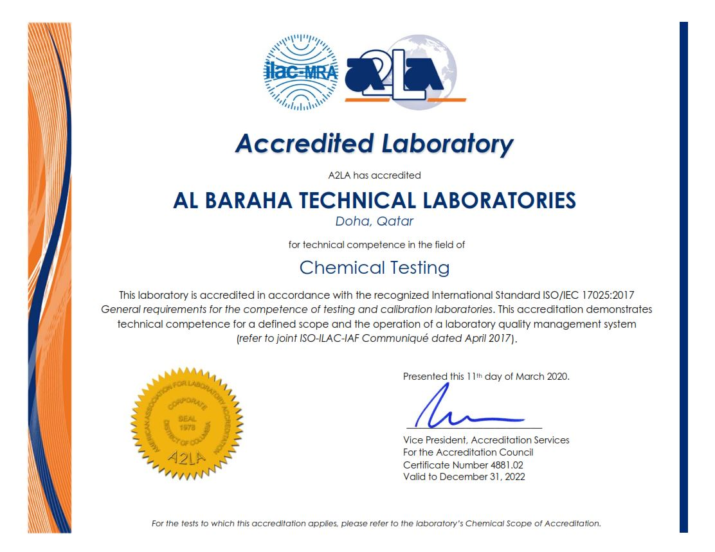
COMPANY PROFILE
7 – BATLABS CREDENTIALS
ISO / IEC : 17025 – 2017 Certificate
Page 42

Slide 46
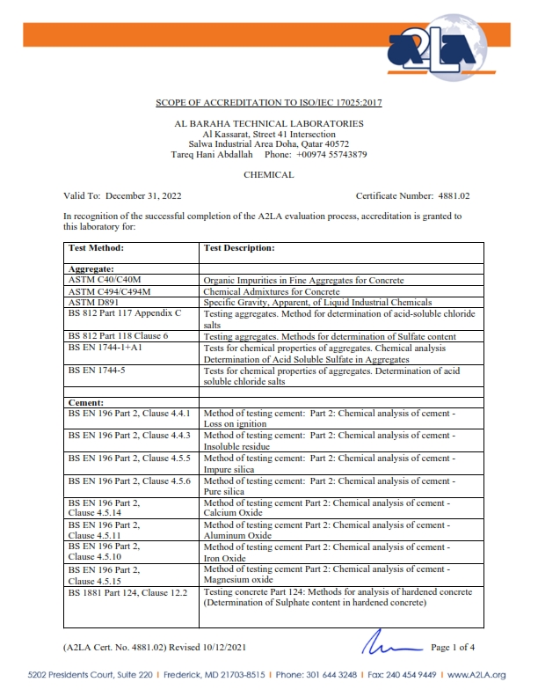
COMPANY PROFILE
7 – BATLABS CREDENTIALS
ISO / IEC : 17025 – 2017 Certificate
Page 43

Slide 47
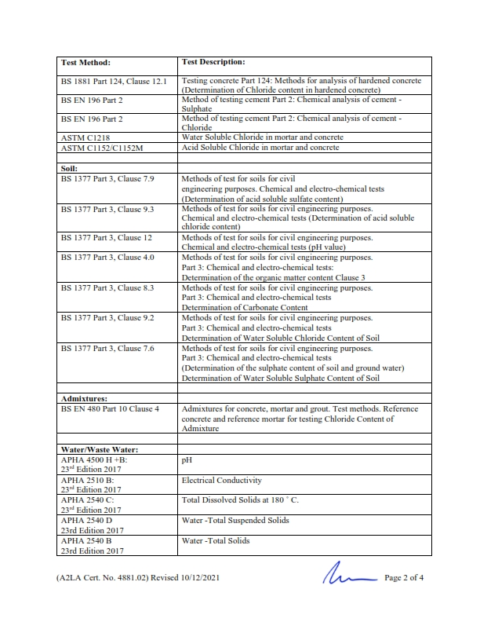
COMPANY PROFILE
7 – BATLABS CREDENTIALS
ISO / IEC : 17025 – 2017 Certificate
Page 44

Slide 48
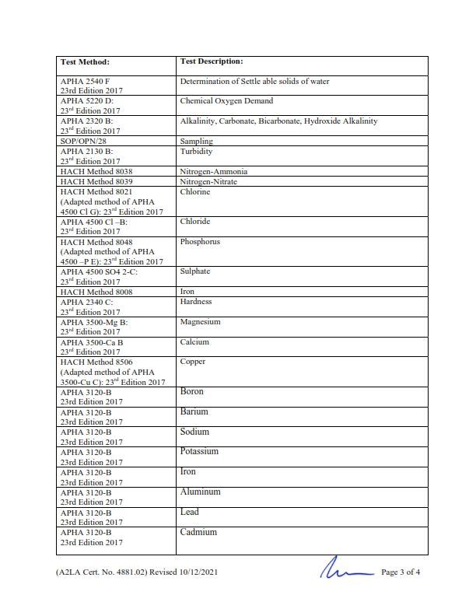
COMPANY PROFILE
7 – BATLABS CREDENTIALS
ISO / IEC : 17025 – 2017 Certificate
Page 45

Slide 49
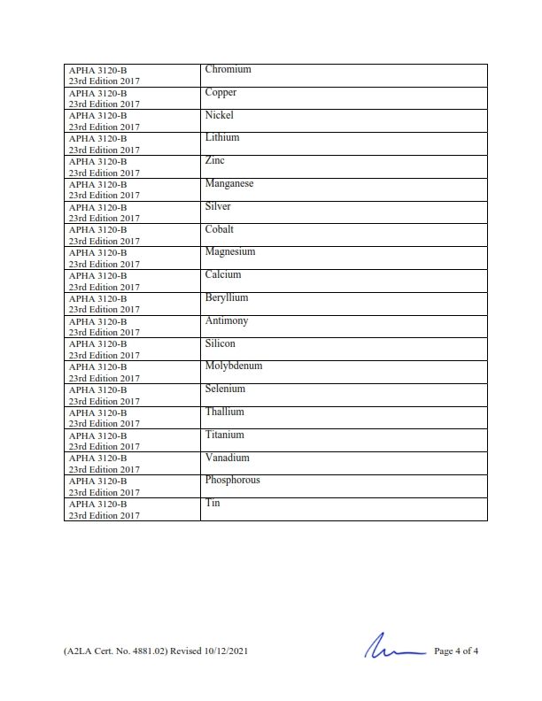
COMPANY PROFILE
7 – BATLABS CREDENTIALS
ISO / IEC : 17025 – 2017 Certificate
Page 45

Slide 50
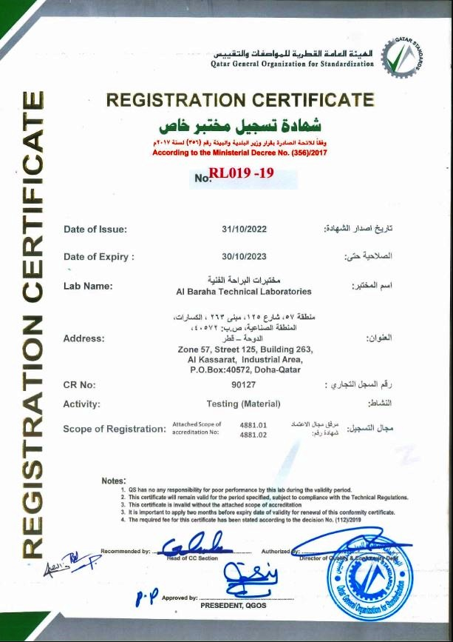
COMPANY PROFILE
7 – BATLABS CREDENTIALS
MOE Certificate
Page 46

Slide 51
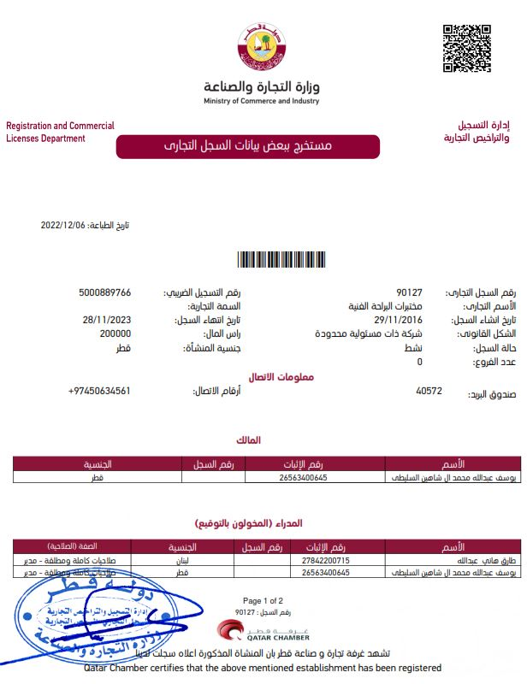
COMPANY PROFILE
7 – BATLABS CREDENTIALS
Commercial Registration
Page 47

Slide 52
COMPANY PROFILE
7 – BATLABS CREDENTIALS
Commercial Registration
Page 48

Slide 53
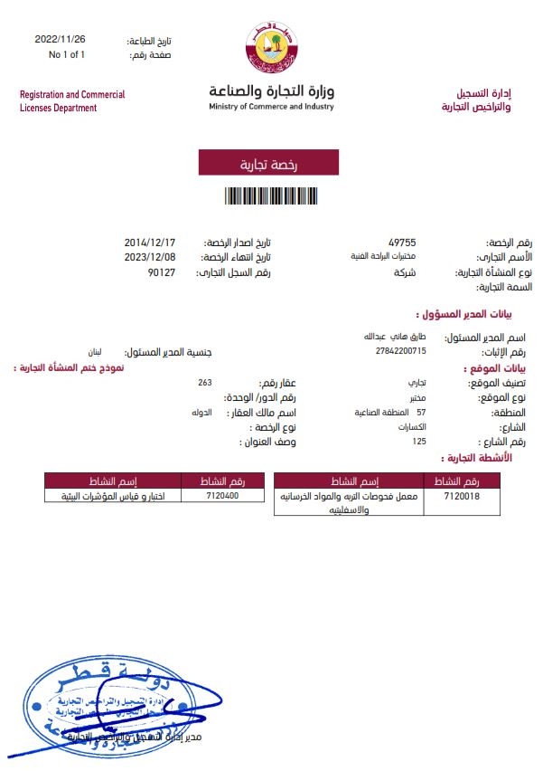
COMPANY PROFILE
7 – BATLABS CREDENTIALS
Commercial Registration
Page 49

Slide 54
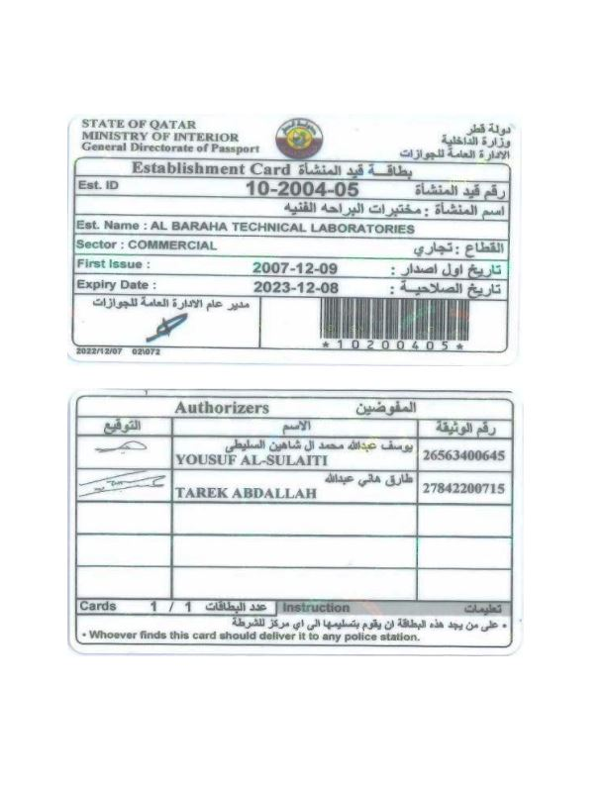
COMPANY PROFILE
7 – BATLABS CREDENTIALS
Computer Card
Page 50

Slide 55
COMPANY PROFILE
7 – BATLABS CREDENTIALS
Qatar Chamber of Commerce & Industry Membership Certificate
Page 51

Slide 56
COMPANY PROFILE
BATLABS is taking a huge step towards Quality and System improvement in order to fulfill our promise to satisfy and exceed all the needs of our valued customers…
Our ULTIMATE GOAL is to achieve
“TOTAL CUSTOMER SATISFACTION”
BATLABs is ….
“YOUR DEPENDABLE PROJECT PARTNER”

